Slide 1
UML Diagrams
Flight Delay Prediction --- SOE 532C

Slide 2
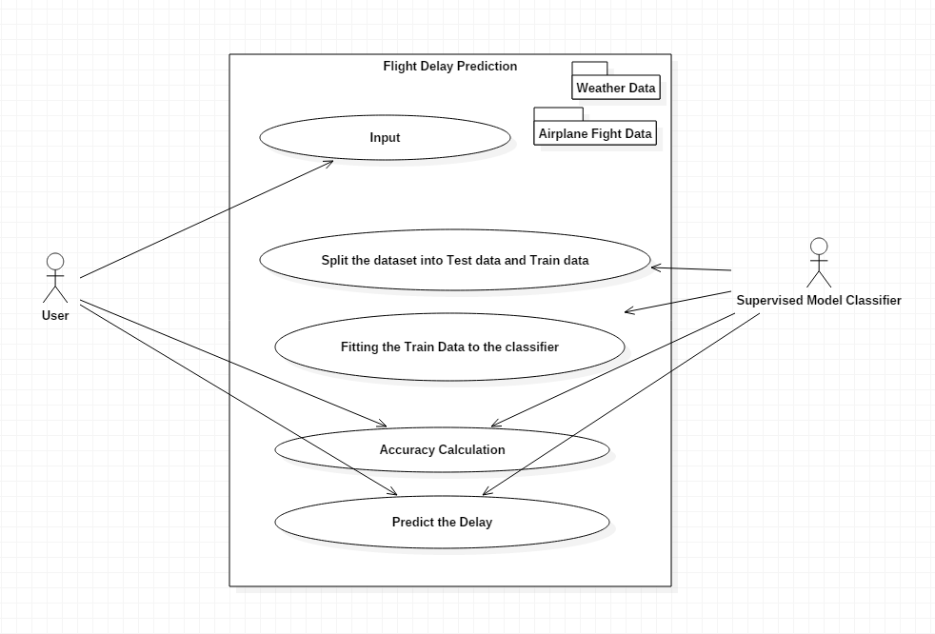
Use Case Diagram

Slide 3
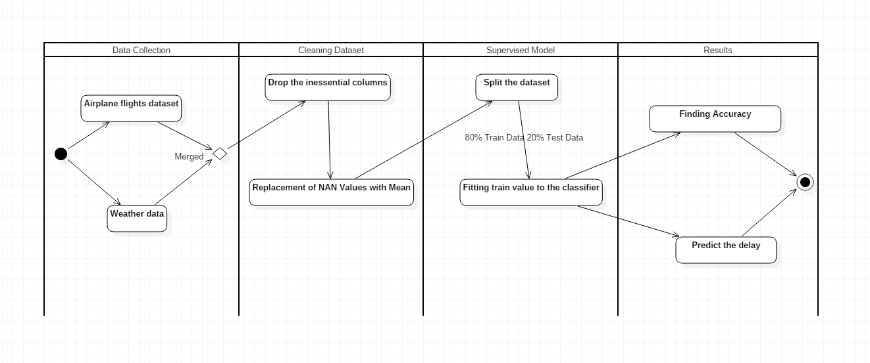
Activity Diagram

Slide 4
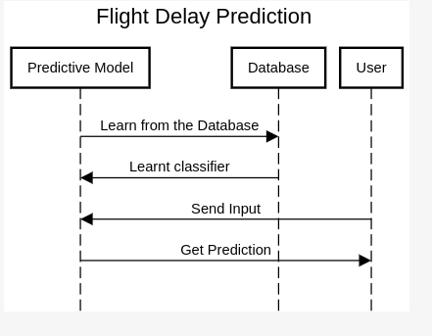
Sequence Diagram

Slide 5
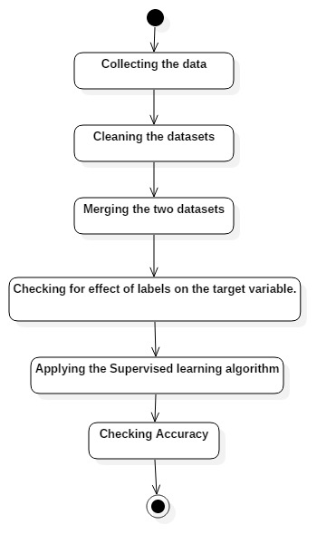
Flow Chart Diagram

